Slide 1

Generative AI Assistant and Knowledge base for pharmaceuticals
Anthony Nissy | 2520030064
P. Anuradha Nandini | 2520030171
K. Shashank Reddy | 2520030215
Under the Guidance
of
Dr. Spandana. s
Assistant Professor
Department of Computer Science and Engineering
KONERU LAKSHMAIAH EDUCATION FOUNDATION

Slide 2
GROUP NUMBER:1
Name of Candidate | Role
Anthony Nissy- 2520030064
P. Anuradha Nandini- 2520030171
K. Shashank Reddy - 2520030215

Slide 3
ABSTRACT
Generative AI Assistant and Knowledge Base for Pharmaceuticals is developed to provide users with reliable, accurate, and easy-to-understand information about medicines. The system can answer queries related to drug uses, dosage, side effects, drug interactions, precautions, and pharmaceutical documents. It uses Generative AI and RAG (Retrieval-Augmented Generation) to search relevant information from a trusted knowledge base before generating a response. This helps the system provide more context-aware answers and reduces the chances of AI hallucinations.
The system uses different databases for managing different types of information. PostgreSQL stores structured data such as drug details, manufacturers, prescriptions, and user information, while MongoDB stores semi-structured information such as drug leaflets, FAQs, and clinical notes. pgvector is used to perform semantic or meaning-based searches, helping the AI find the most relevant information. The backend follows a microservices architecture, where different services handle authentication, user management, drug information, knowledge retrieval, and AI-based responses separately. Technologies such as Fast API, Node.js, Kafka, and Docker are used to build and deploy the system.
The final application provides a simple interface where patients, pharmacists, clinicians, and healthcare professionals can ask pharmaceutical-related questions and receive AI-generated responses based on verified information. The main aim of the project is to make pharmaceutical knowledge faster, easier, and more reliable to access, while providing a scalable system that can be updated with new information in the future.

Slide 4
INTRDOUCTION
Generative AI Assistant for Pharmaceuticals is an AI-based system designed to provide reliable pharmaceutical information.
It helps users find information about medicines, dosage, side effects, drug interactions, and precautions.
Uses Generative AI and RAG (Retrieval-Augmented Generation) to provide context-based answers.
Retrieves information from a trusted and continuously updated knowledge base.
Uses PostgreSQL, MongoDB, and pgvector to manage different types of pharmaceutical data.
Built using a microservices architecture for better scalability and flexibility.
Uses FastAPI and Node.js/Spring Boot for backend services.
Docker is used to containerize and simplify deployment.
Helps reduce AI hallucinations by grounding responses in verified information.
Designed for patients, pharmacists, clinicians, and healthcare professionals.
Improves the accessibility, speed, and reliability of pharmaceutical knowledge.

Slide 5
EXISTING SYSTEM
- Uses old/traditional databases to store medicine information.
- Provides details like dosage, side effects, and drug interactions.
- Mainly uses keyword search to find information.
- Uses basic chatbots to answer simple questions.
- Usually depends on limited data sources.
- Has difficulty understanding natural-language questions.
- Does not usually combine SQL, NoSQL, and vector databases.
- Has limited use of semantic search and RAG.
- Many systems are monolithic, so they are harder to maintain and scale.
- AI may give wrong information without a trusted knowledge base.
- Has limited use of microservices, Kafka, Docker, and CI/CD.
- Overall, existing systems are less intelligent, less flexible, and less scalable.

Slide 6
PROBLEM
- Keyword search may not understand the user's actual question.
- Information is spread across different sources.
- Difficult to handle both structured and unstructured data.
- Provides limited personalized answers.
- Basic chatbots cannot answer complex or new questions.
- AI may give wrong or made-up information.
- Without semantic search, results may be irrelevant.
- Limited use of SQL, NoSQL, and vector databases together.
- Monolithic systems are difficult to scale and maintain.
- Limited use of microservices and fast communication.
- Manual testing and deployment can be slow and error-prone.
- No single platform for complete pharmaceutical information.

Slide 7
SOLUTION(Contribution)
- Develops a Generative AI-powered pharmaceutical assistant for natural-language queries.
- Creates a centralized pharmaceutical knowledge base containing reliable drug-related information.
- Uses PostgreSQL for structured data and MongoDB for semi-structured pharmaceutical documents.
- Uses Vector Database (pgvector) and semantic search to retrieve relevant information based on meaning rather than exact keywords.
- Implements RAG (Retrieval-Augmented Generation) to provide knowledge-grounded AI responses and reduce hallucinations.
- Uses microservices architecture to improve scalability, maintainability, and independent service deployment.
- Provides REST APIs for communication between the frontend and backend services.
- Uses Kafka for asynchronous communication and event processing between services.
- Implements authentication and authorization to protect user and pharmaceutical data.
- Uses Docker containerization for consistent and portable deployment.
- Integrates CI/CD pipelines for automated testing and deployment.
- Provides a user-friendly interface where users can quickly obtain relevant pharmaceutical information from a single platform.

Slide 8
Objectives
- To develop a Generative AI-based pharmaceutical assistant that can understand and respond to user queries.
- To create a reliable pharmaceutical knowledge base for storing drug, dosage, interaction, and medical information.
- To integrate SQL, NoSQL, and Vector Databases for efficient storage and retrieval of different types of pharmaceutical data.
- To implement semantic search and RAG (Retrieval-Augmented Generation) for more relevant and knowledge-grounded responses.
- To reduce AI hallucinations and unsupported answers by using retrieved pharmaceutical information as context.
- To design a microservices-based architecture for scalability, flexibility, and easier maintenance.
- To develop secure and efficient REST APIs for communication between frontend and backend services.
- To use Kafka for asynchronous communication and event processing.
- To implement Docker and CI/CD for automated, consistent, and reliable deployment.
- To provide a user-friendly platform for quick and easy access to pharmaceutical information.

Slide 9
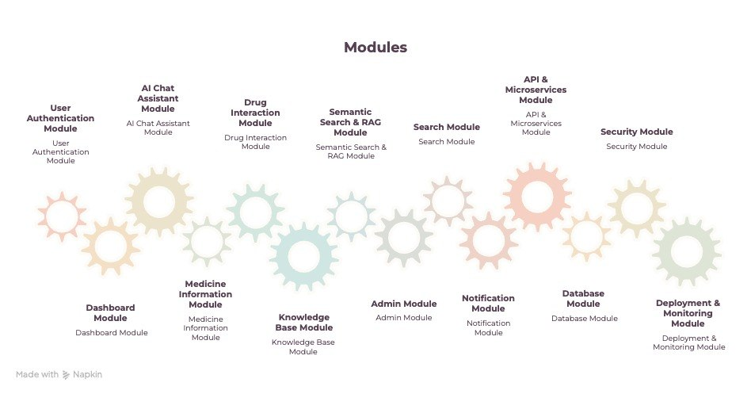
Modules

Slide 10
SOFTWARE REQUIREMENTS
- Operating System: Windows 10/11, Linux, or macOS
- Frontend: HTML5, CSS3, JavaScript / React.js
- Backend: Python with FastAPI
- Additional Backend: Node.js with Express.js / Spring Boot
- Databases: PostgreSQL and MongoDB
- Vector Database: PostgreSQL with pgvector
- Generative AI: LLM / Generative AI API
- RAG: Embedding model and Retrieval-Augmented Generation framework
- API Testing: Postman
- Messaging: Apache Kafka
- Containerization: Docker and Docker Compose
- Version Control: Git and GitHub
- CI/CD: GitHub Actions
- Documentation: OpenAPI / Swagger and C4 Model
- Development Environment: Visual Studio Code
- Web Browser: Google Chrome / Microsoft Edge / Mozilla Firefox

Slide 11
CONCLUSION AND FUTURE SCOPE
- Provides an intelligent pharmaceutical information assistant.
- Uses Generative AI, SQL, NoSQL, Vector DB, Semantic Search, and RAG.
- Gives accurate and context-based answers using trusted knowledge.
- Uses REST APIs, Microservices, Kafka, Docker, and CI/CD.
- Makes the system scalable, reliable, and easy to maintain.
- Combines modern technologies to improve pharmaceutical information access.
Future Scope – Simple Words
- Use advanced medical AI models.
- Connect to real-time medicine and regulatory databases.
- Add voice-based interaction.
- Support multiple languages.
- Provide personalized medicine information safely.
- Improve security and user access control.
- Deploy on the cloud with auto-scaling.
- Support doctors, pharmacists, researchers, and hospitals.
- Continuously monitor and improve AI accuracy.

Slide 12
THANK YOU

